Slide 1
ENGR 12
Dr. Mandala
Notes:
Down

Slide 2
Basic Stats
What is the center of a dataset, or around what value does the dataset cluster?
We use three measurements to describe this central tendency: Mean, Median, and Mode
MATLAB Code: mean(values), median(values), mode(values)
values is an array of data
What is the dispersion or spread around the center?
We use Max, Min, Range, Variance, and Standard Deviation to describe this
MATLAB Code: max(values), min(values), var(values), std(values)
Range=Max-Min

Slide 3
How to calculate manually?
Mean: Section 4.12.1
Sum up all values and divide by length of array
Median: Section 4.12.2
Sort the array and find the central value
Mode: Section 4.12.3
Sort the array and count the most repeated value
Note: An array can have 0 or more mode values
Min & Max: 4.12.4
Sort the array and find the first and last element
Variance: 4.12.5
Sum of squared difference of value from mean divided by (length-1)
Standard Deviation: 4.12.6
Square root of variance

Slide 4
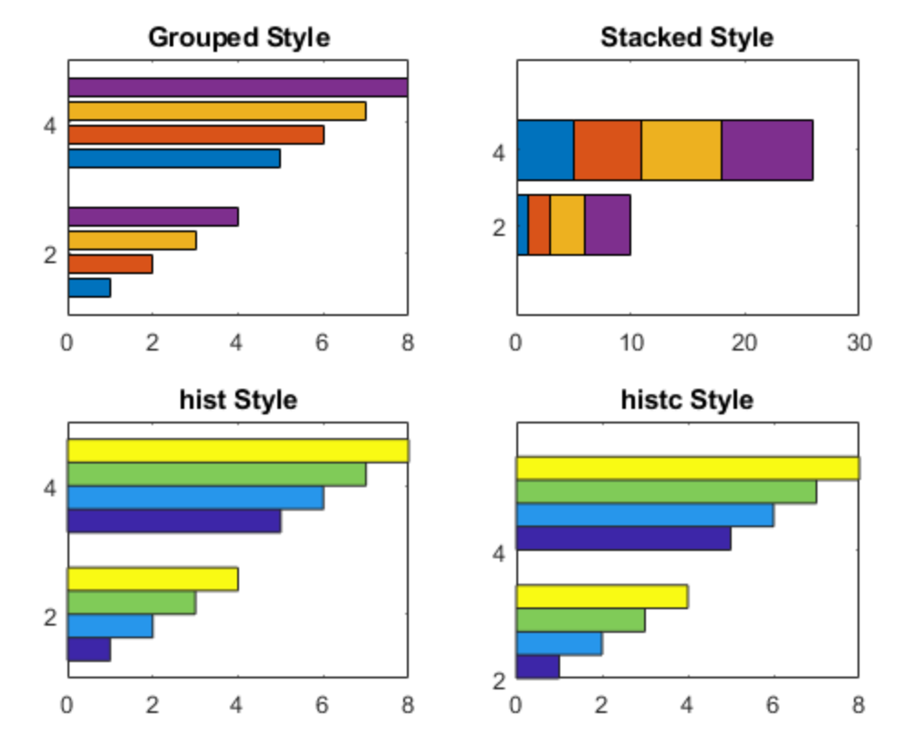
Histograms (Section 4.12.7)

Slide 5
Basic steps
Calculate RANGE of data (MAX-MIN)
Divide this RANGE into adjacent bins (equal spaced intervals)
Count the upper and lower bounds of bins
Count data points in each bin
Note: Data belongs to a bin if its equal to or greater than lower bound AND lesser than upper bound.
Plot the number of data points in each bin as bar chart

Slide 6
BAR Command
Creates a vertical bar-plot
MATLAB Command: bar(x,y,style)
x is an array defining x-values
y is an array defining y-values
style=‘grouped’,’stacked’,’hist’,’histc’ and is optional
To create Histogram
x = array containing bin left bound
y = array containing frequency count of data per bin
Notes:
grades=[71,58,75,90,82,89,85,94,90,81,97,94,93,...
65,48,62,80,85,90,86,85,78,79,60,89];

Slide 7
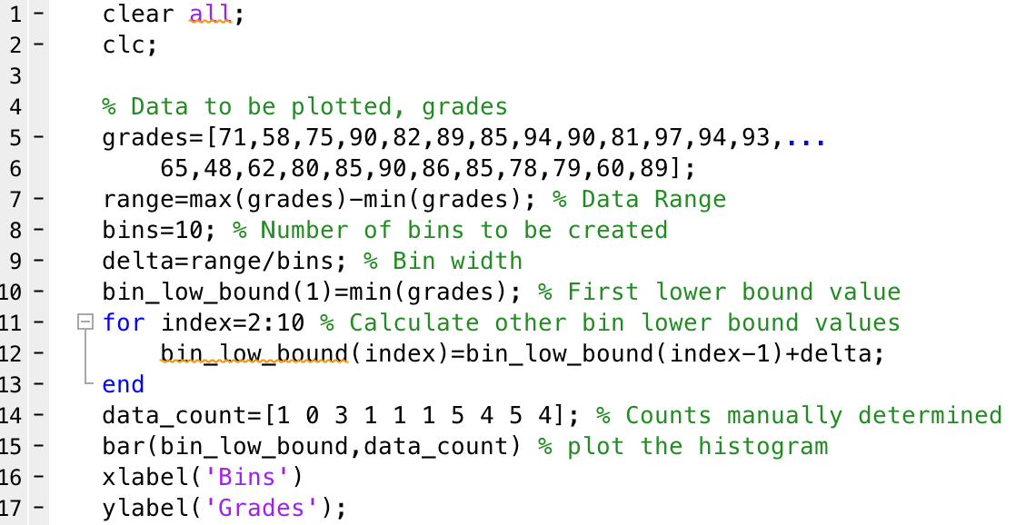
Sample code: Histogram manual
Notes:
grades=[71,58,75,90,82,89,85,94,90,81,97,94,93,...
65,48,62,80,85,90,86,85,78,79,60,89];

Slide 8
Using Hist and Histc
hist and histc can calculate the bin frequency automatically
histc requires data array and edge array (bin lower bound) as input argument
ncount = histc(grades,bin_low_bound)
[ncount,bincount]=histc(grades,bin_low_bound)
Note: edge array should contain upper bound as the last value
hist requires data array and number of bins as input arguments
ncount = hist(grades,10)
[ncount, bin_low_bound]=hist(grades,10)
Note: number of bins is option, and default is 10.

Slide 9
Histograms
You can use, hist, histc, or histogram commands to create histograms automatically
Example: >> histogram(grades,10)
MATLAB recommends using histogram and histcounts
Newer features
Output of the function creates an object (structured data type)
>> N = histogram(grades,10);
>> N.Values would contain the Bin counts
Notes:
dia=[1,1.25,1.5,2,2.5,3,3.5,4,5,6,8];
mass=[1.68,2.27,2.72,3.65,5.79,7.58,9.11,10.79,14.62,18.97,28.55];

Slide 10
Plots (section 4.13.1)
Engineers frequently plot either a measured or calculated dependent variable, say y, versus an independent variable, say x. A simple y versus x plot is obtained with the command plot(x,y)
x=[0, 1, 2, 3, 4, 5, 6 ,7 ,8]; % independent values
y=[0, 1, 4, 9, 16, 25 ,36 ,49 ,64]; % dependent values
plot(x,y) % plot y versus x
Notes:
dia=[1,1.25,1.5,2,2.5,3,3.5,4,5,6,8];
mass=[1.68,2.27,2.72,3.65,5.79,7.58,9.11,10.79,14.62,18.97,28.55];

Slide 11
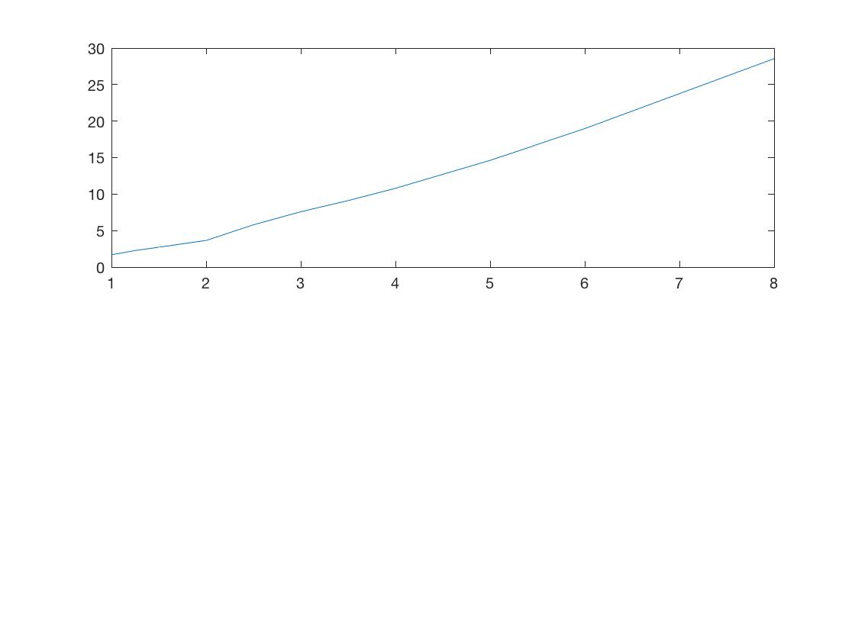
Sample Plot
Notes:
dia=[1,1.25,1.5,2,2.5,3,3.5,4,5,6,8];
mass=[1.68,2.27,2.72,3.65,5.79,7.58,9.11,10.79,14.62,18.97,28.55];

Slide 12
Add info to plots
x=[0, 1, 2, 3, 4, 5, 6 ,7 ,8]; %independent values
y=[0, 1, 4, 9, 16, 25 ,36 ,49 ,64]; %dependent values
plot(x,y) %plot y versus x
figure %now, create a new figure window
plot(x,y) %plot y versus x
grid %add grid lines
title('y = x^2’) %add graph title (note single quotes)
xlabel('x axis’) %add x-axis label (note single quotes)
ylabel('y axis') %add y-axis label (note single quotes)
Notes:
dia=[1,1.25,1.5,2,2.5,3,3.5,4,5,6,8];
mass=[1.68,2.27,2.72,3.65,5.79,7.58,9.11,10.79,14.62,18.97,28.55];

Slide 13
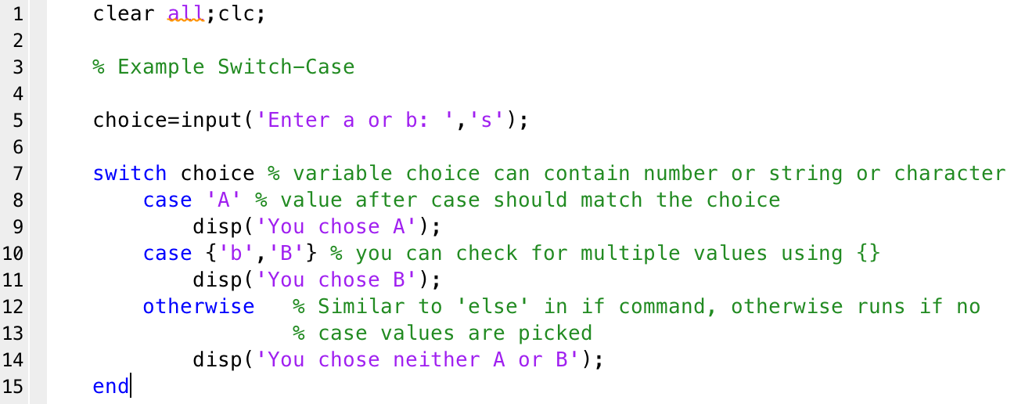
Switch-Case

Slide 14
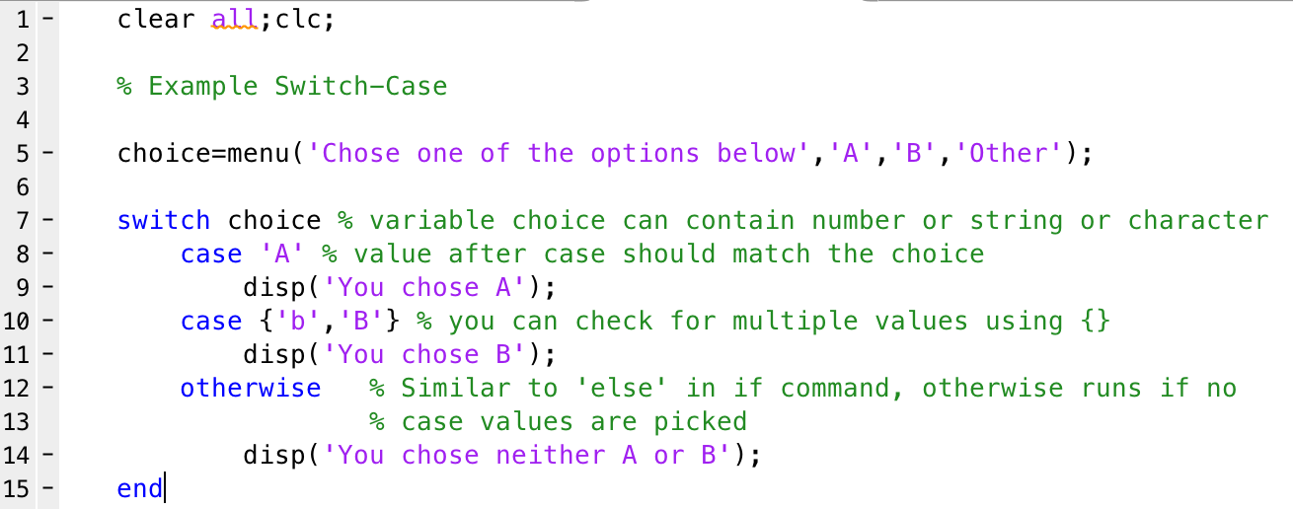
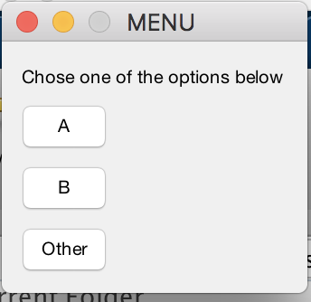
MENU Command
Syntax of menu command:
variable=menu(‘Title’, ‘Button Value#1’, ‘Button value#2’ …)
Variable will contain button number (1, 2, 3 …)
Notes:
Output will contain a number corresponding to the button = 1 thru number of buttons

Slide 15
Acknowledgment
Based on handouts and lectures by Dr. Arash Mehboobin

